Slide 1
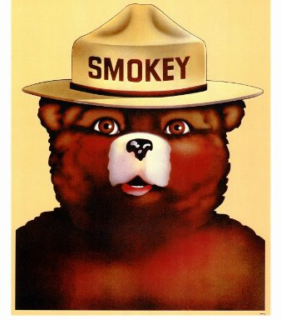
Team Smokey Bear Members: Chris Brady, Marlon Bradford, Liza Hartlaub, Micah Wu, Dawit Hailu, Raul Hennings

Slide 2
Objective
Can we use the power of ML to predict daily Air Quality Index (AQI) in Berkeley, CA using the following variables:
Acres burned by wildfires in Northern California
Precipitation
Humidity
Wind Speed
Wind Direction
Temperature
Cloud Cover
Temp (F)
The dataset includes daily measurements of the variables above from 01/01/2017-12/31/2018 (2 years – 730 rows).

Slide 3
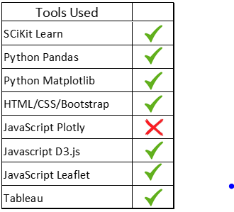

Slide 4
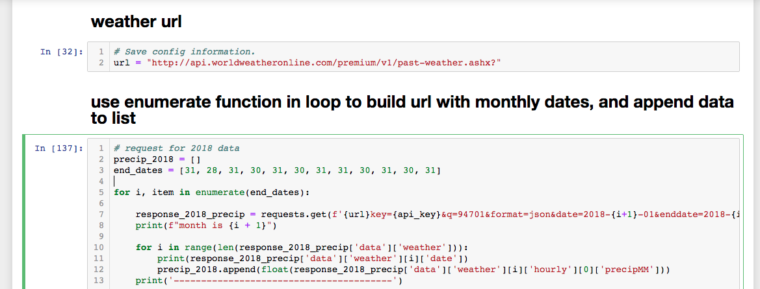
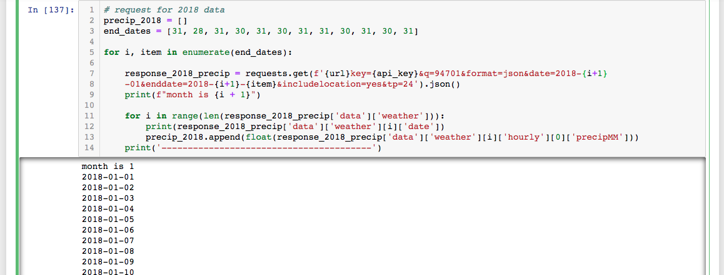
API call to world-weather-online to retrieve weather data of Berkeley from year 2017-2018

Slide 5
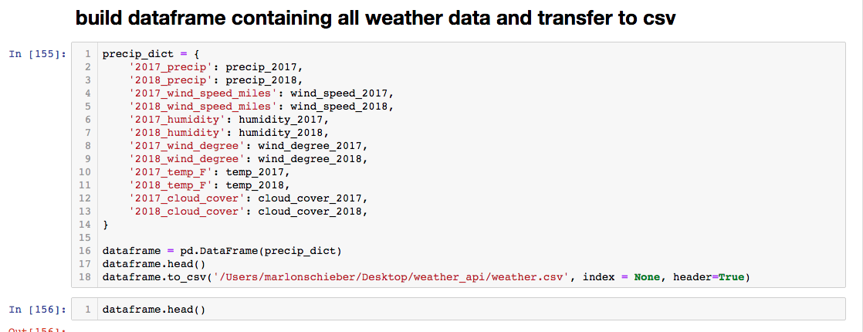
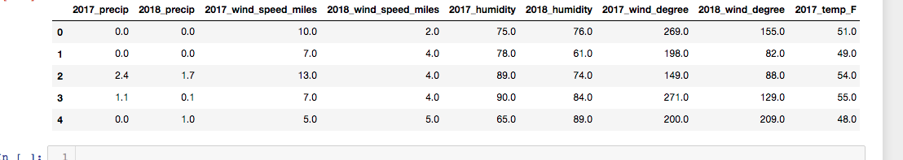

Slide 6
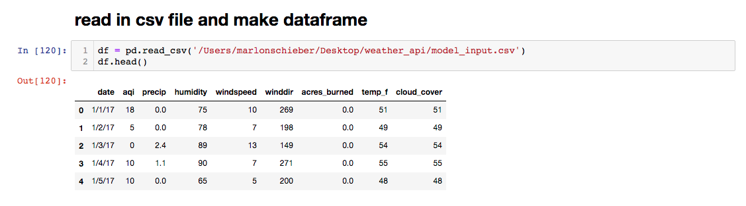
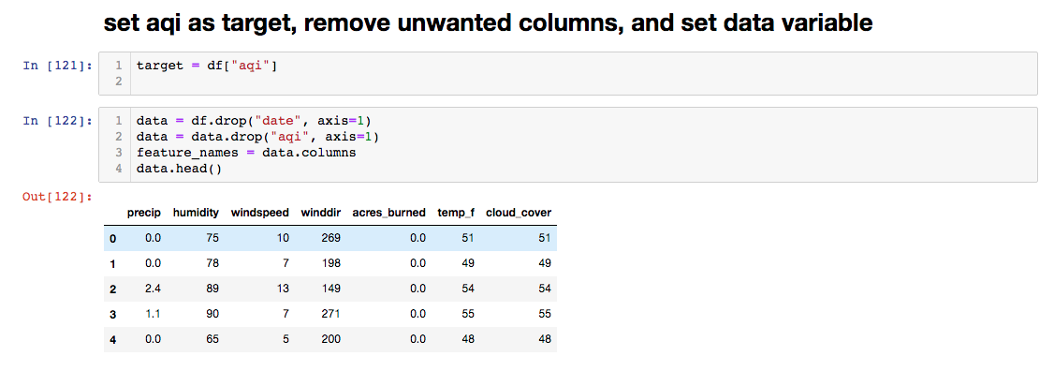
Use decision tree and random forest to build classification models

Slide 7
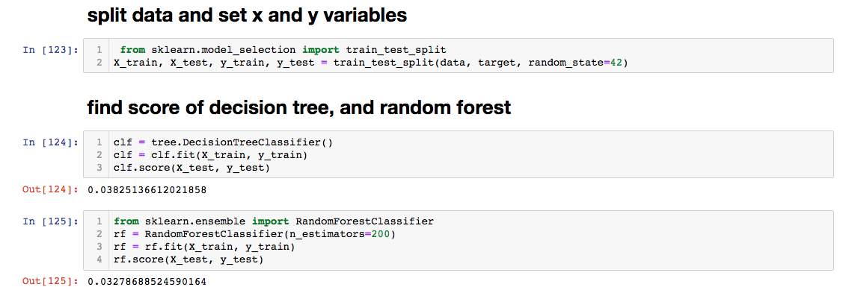

Slide 8
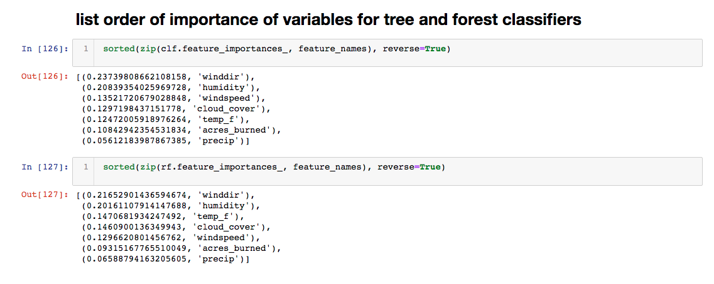

Slide 9
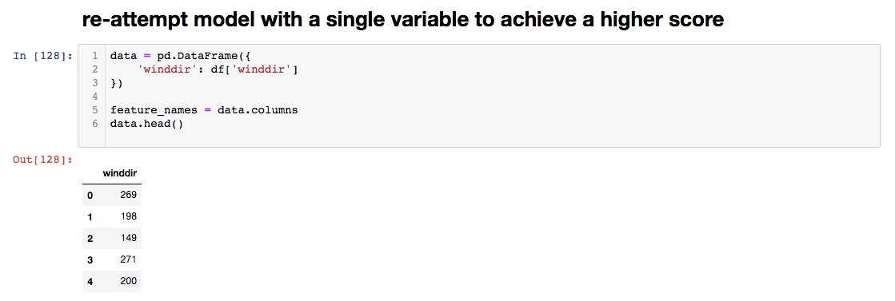
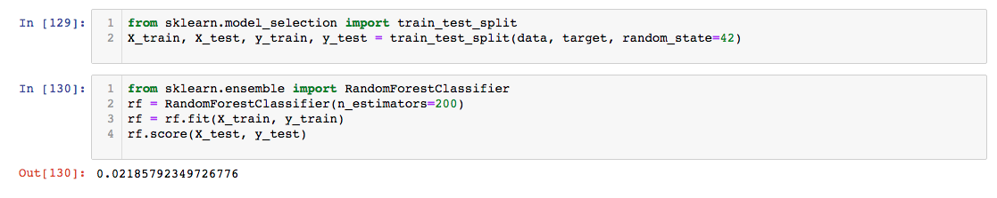

Slide 10
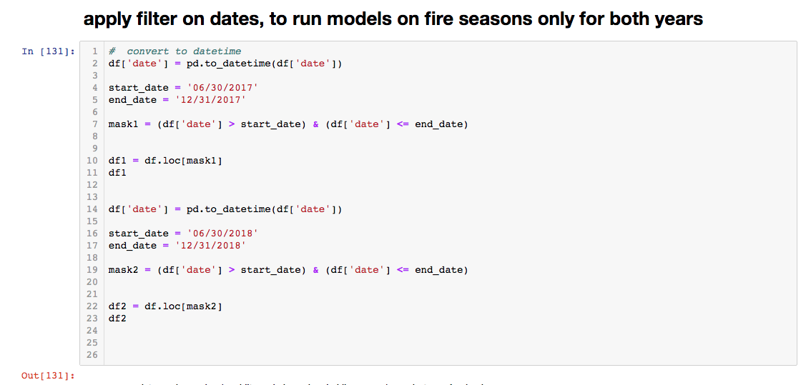

Slide 11
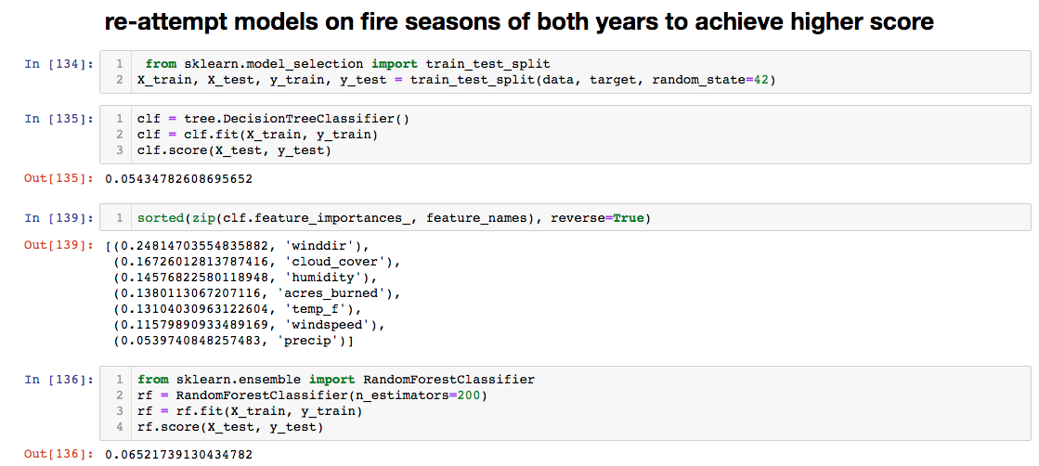

Slide 12
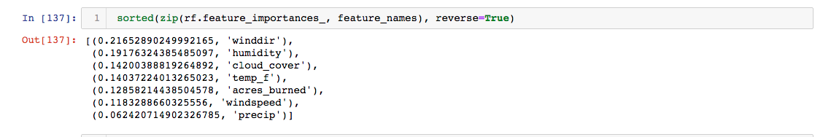
Fire season:
Full 2017, 20018:

Slide 13
Model Test Summaries
Basic Multivariate Linear Regression
LinearRegression (copy_X=True, fit_intercept=True, n_jobs=None, normalize=False)
Training Score: 0.2801
Testing Score: 0.3634
R2 Score: 0.30255
Lasso Model (least absolute shrinkage and selection operator) - performs both variable selection and regularization in order to enhance prediction accuracy;
MSE: 0.6641
R2: 0.3626
Ridge Model - the most commonly used method of regularization of ill-posed problems. if no “x” satisfies the equation or more than one “x” does—that is, the solution is not unique—the problem is said to be ill posed.
MSE: 0.6633
R2: 0.3634
Elasticnet Model - a regularized regression method that linearly combines the L1 and L2 penalties of the lasso and ridge methods.
MSE: 0.6638
R2: 0.3629

Slide 14
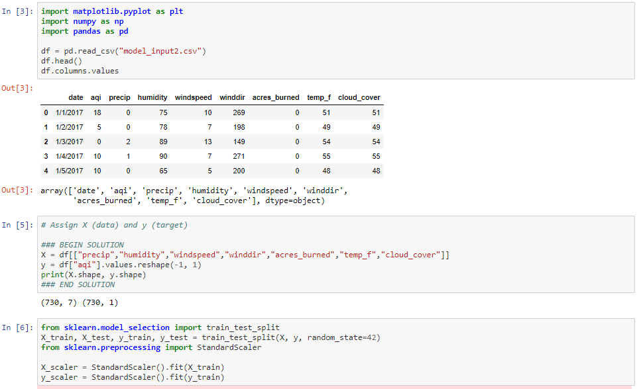

Slide 15
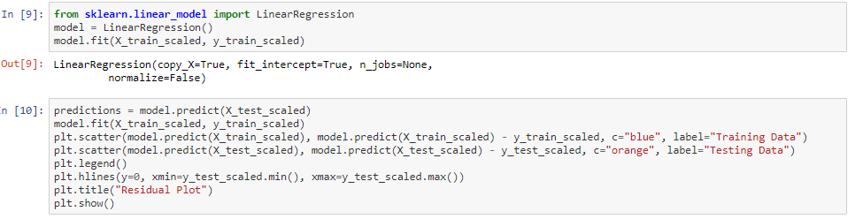
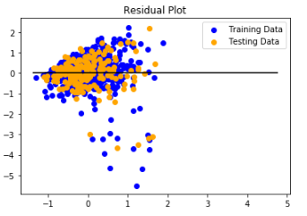

Slide 16
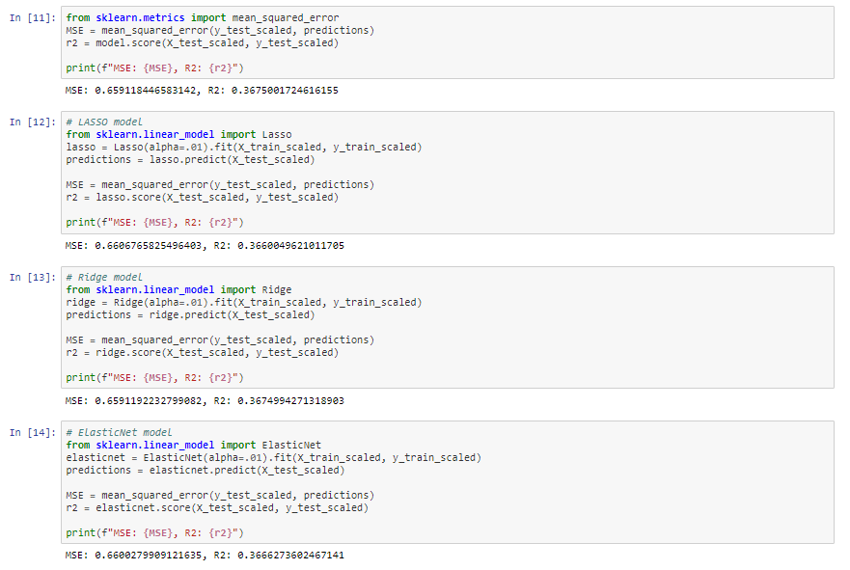

Slide 17
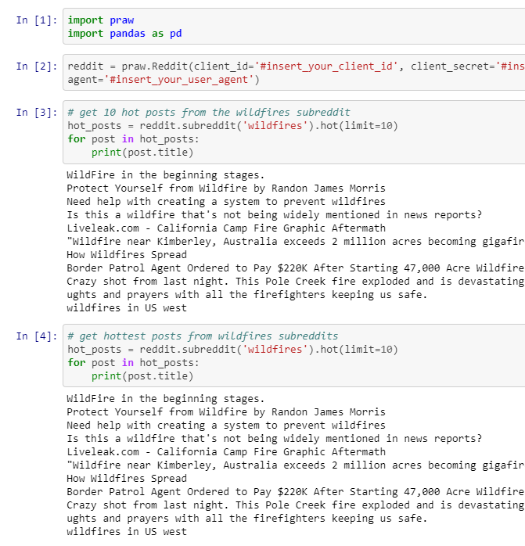
Web Scraping Reddit for info on California Wildfires

Slide 18
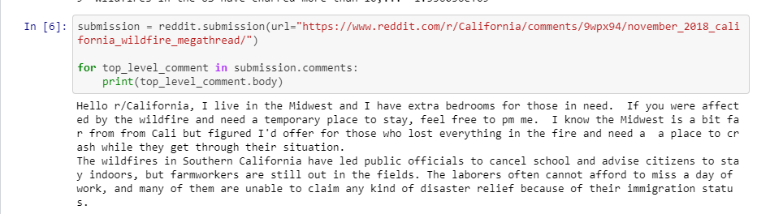
Camp Fire

Slide 19
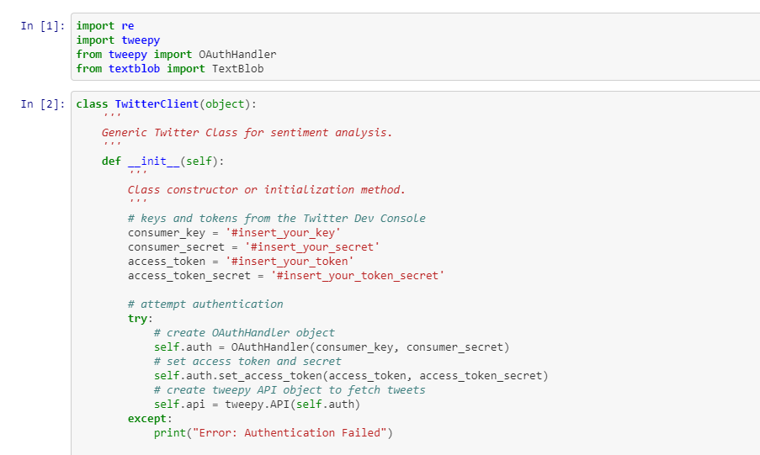
Twitter Sentiment Analysis

Slide 20
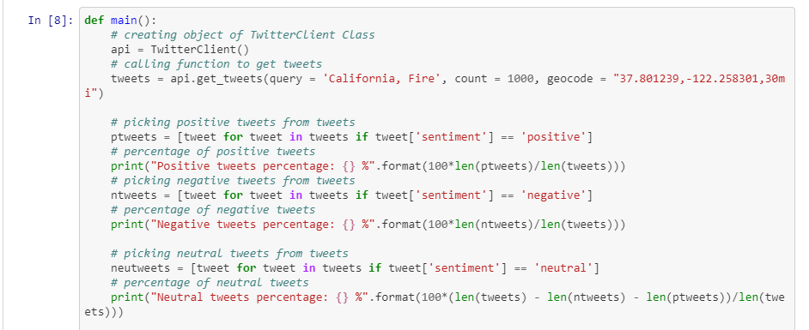
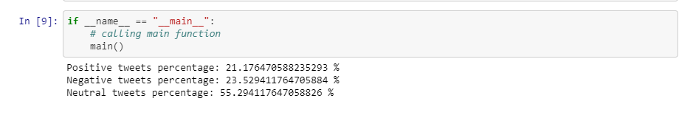

Slide 21
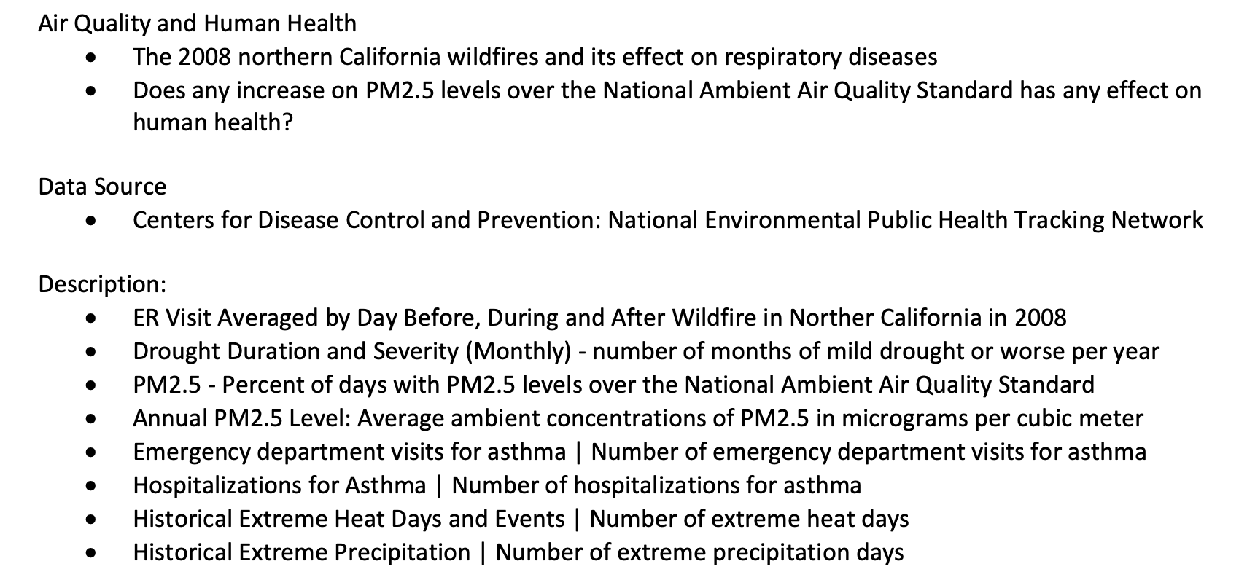
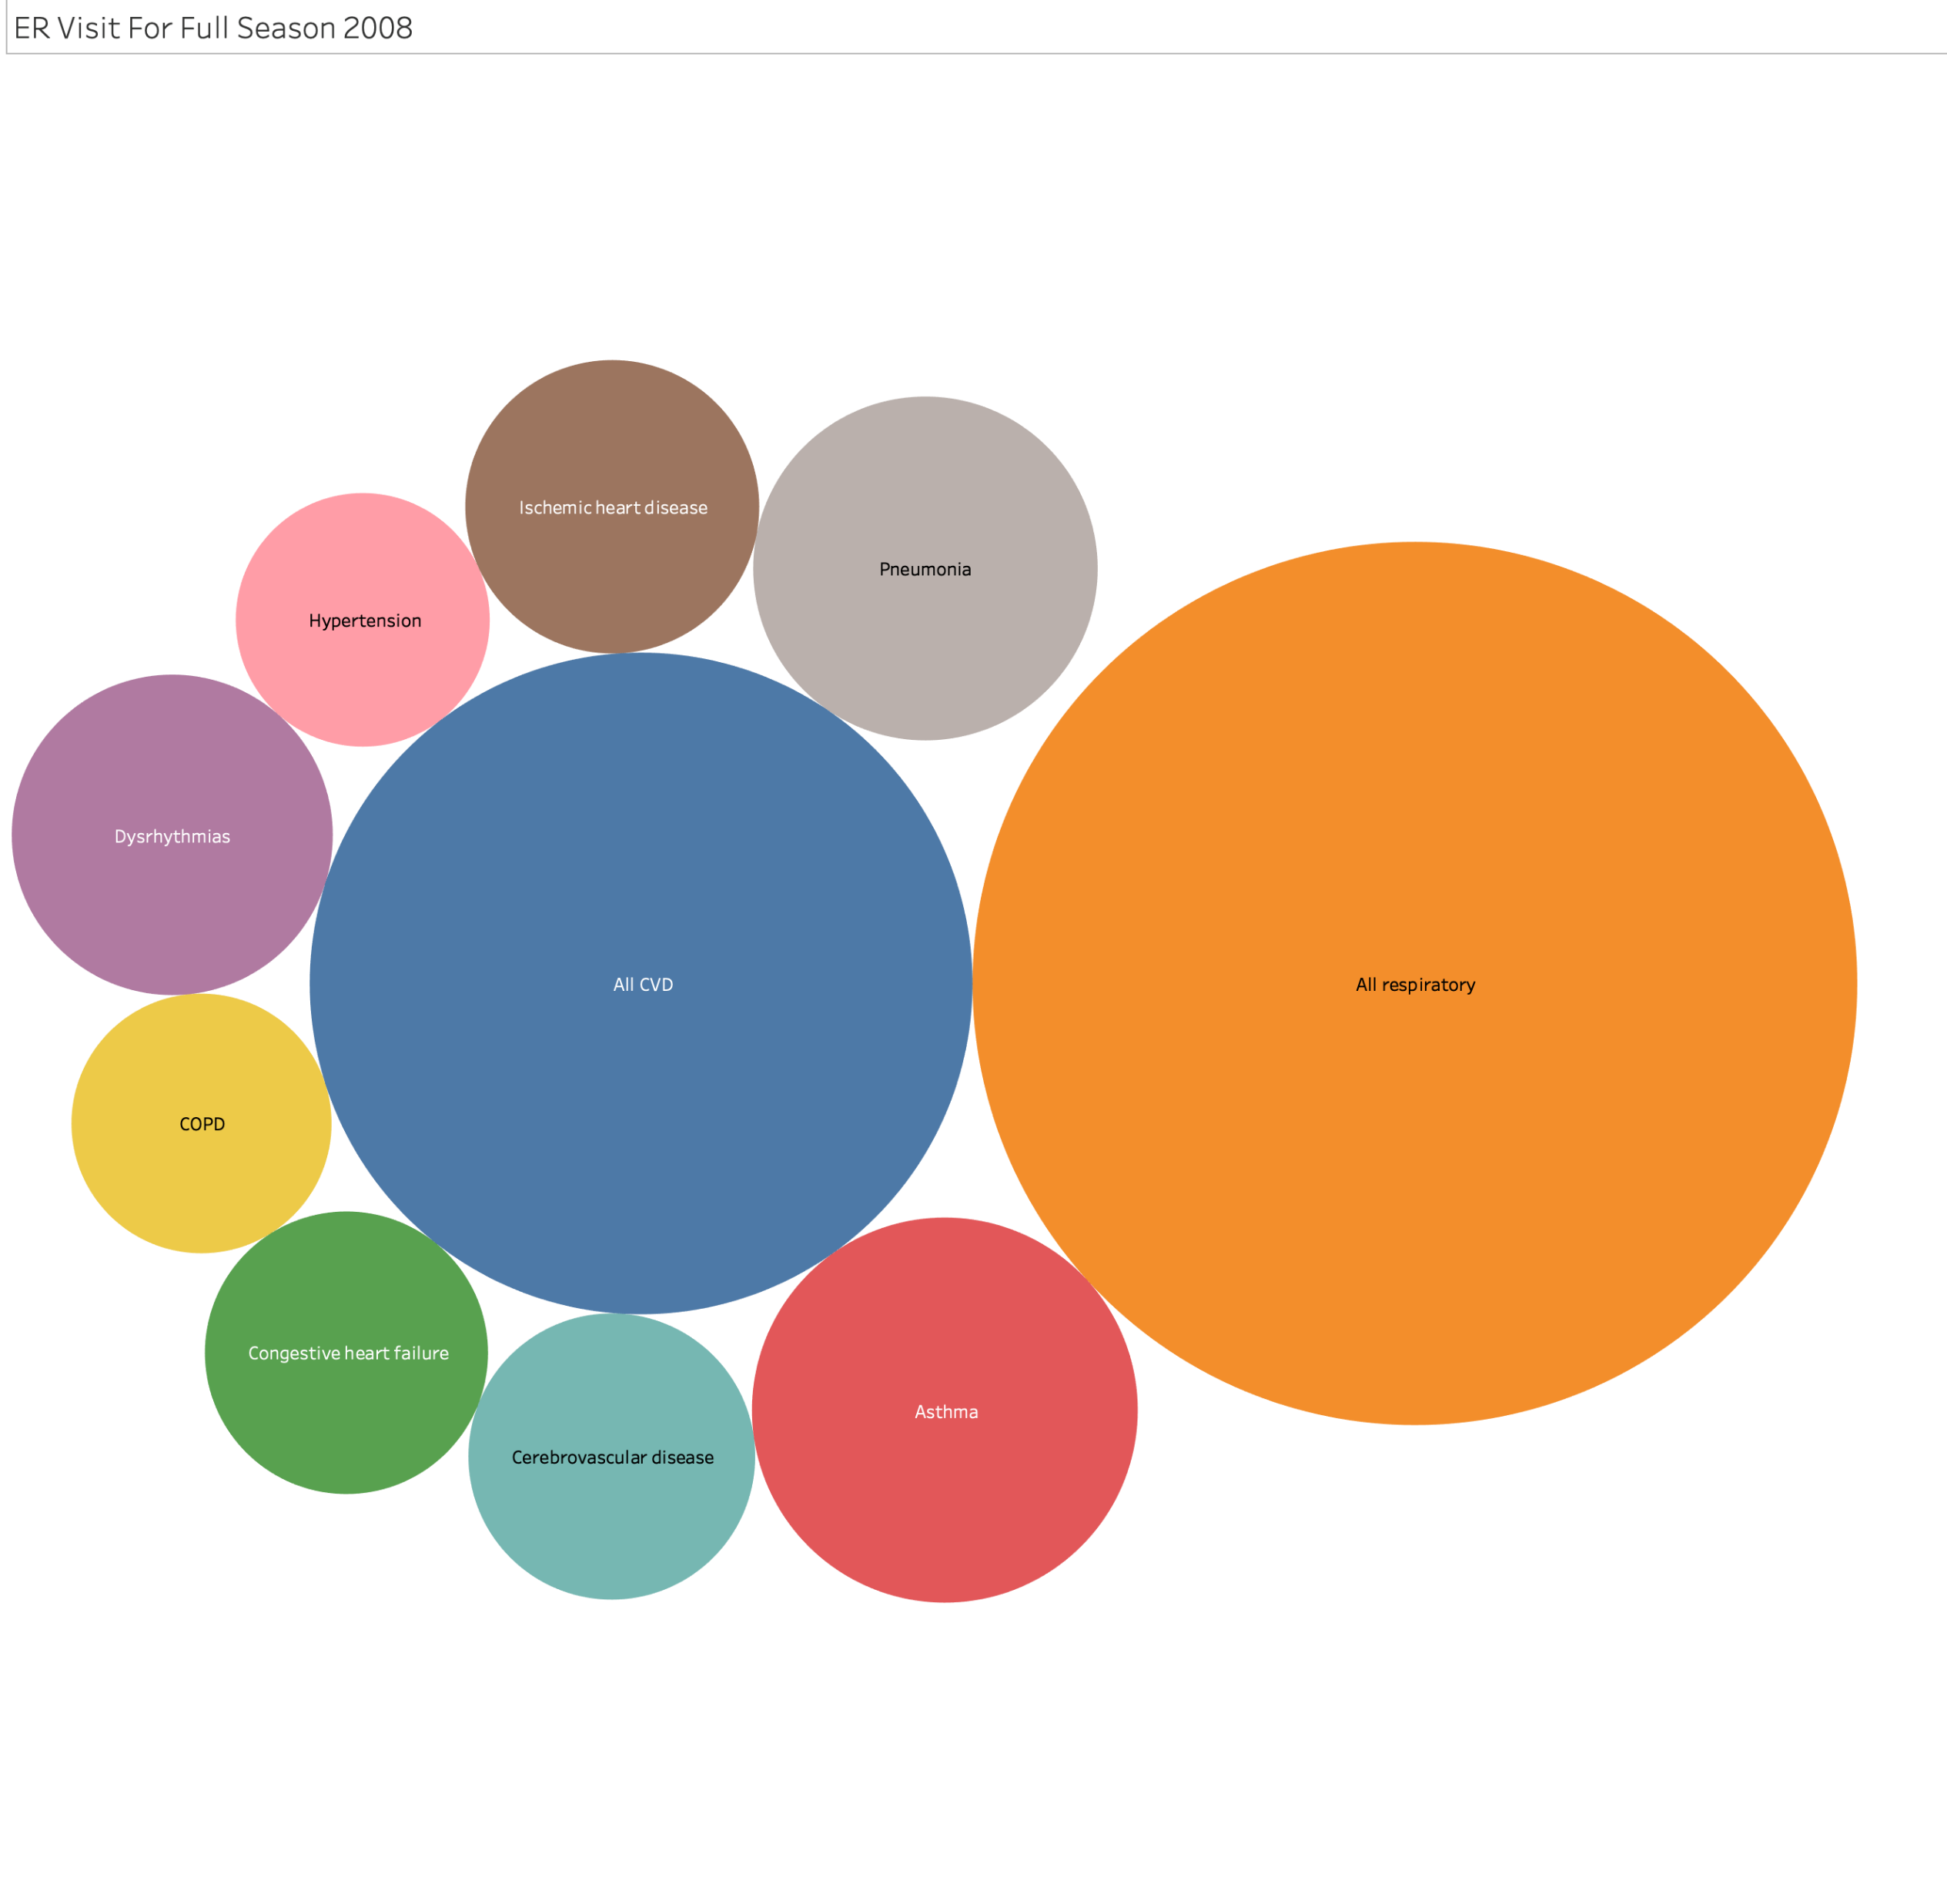
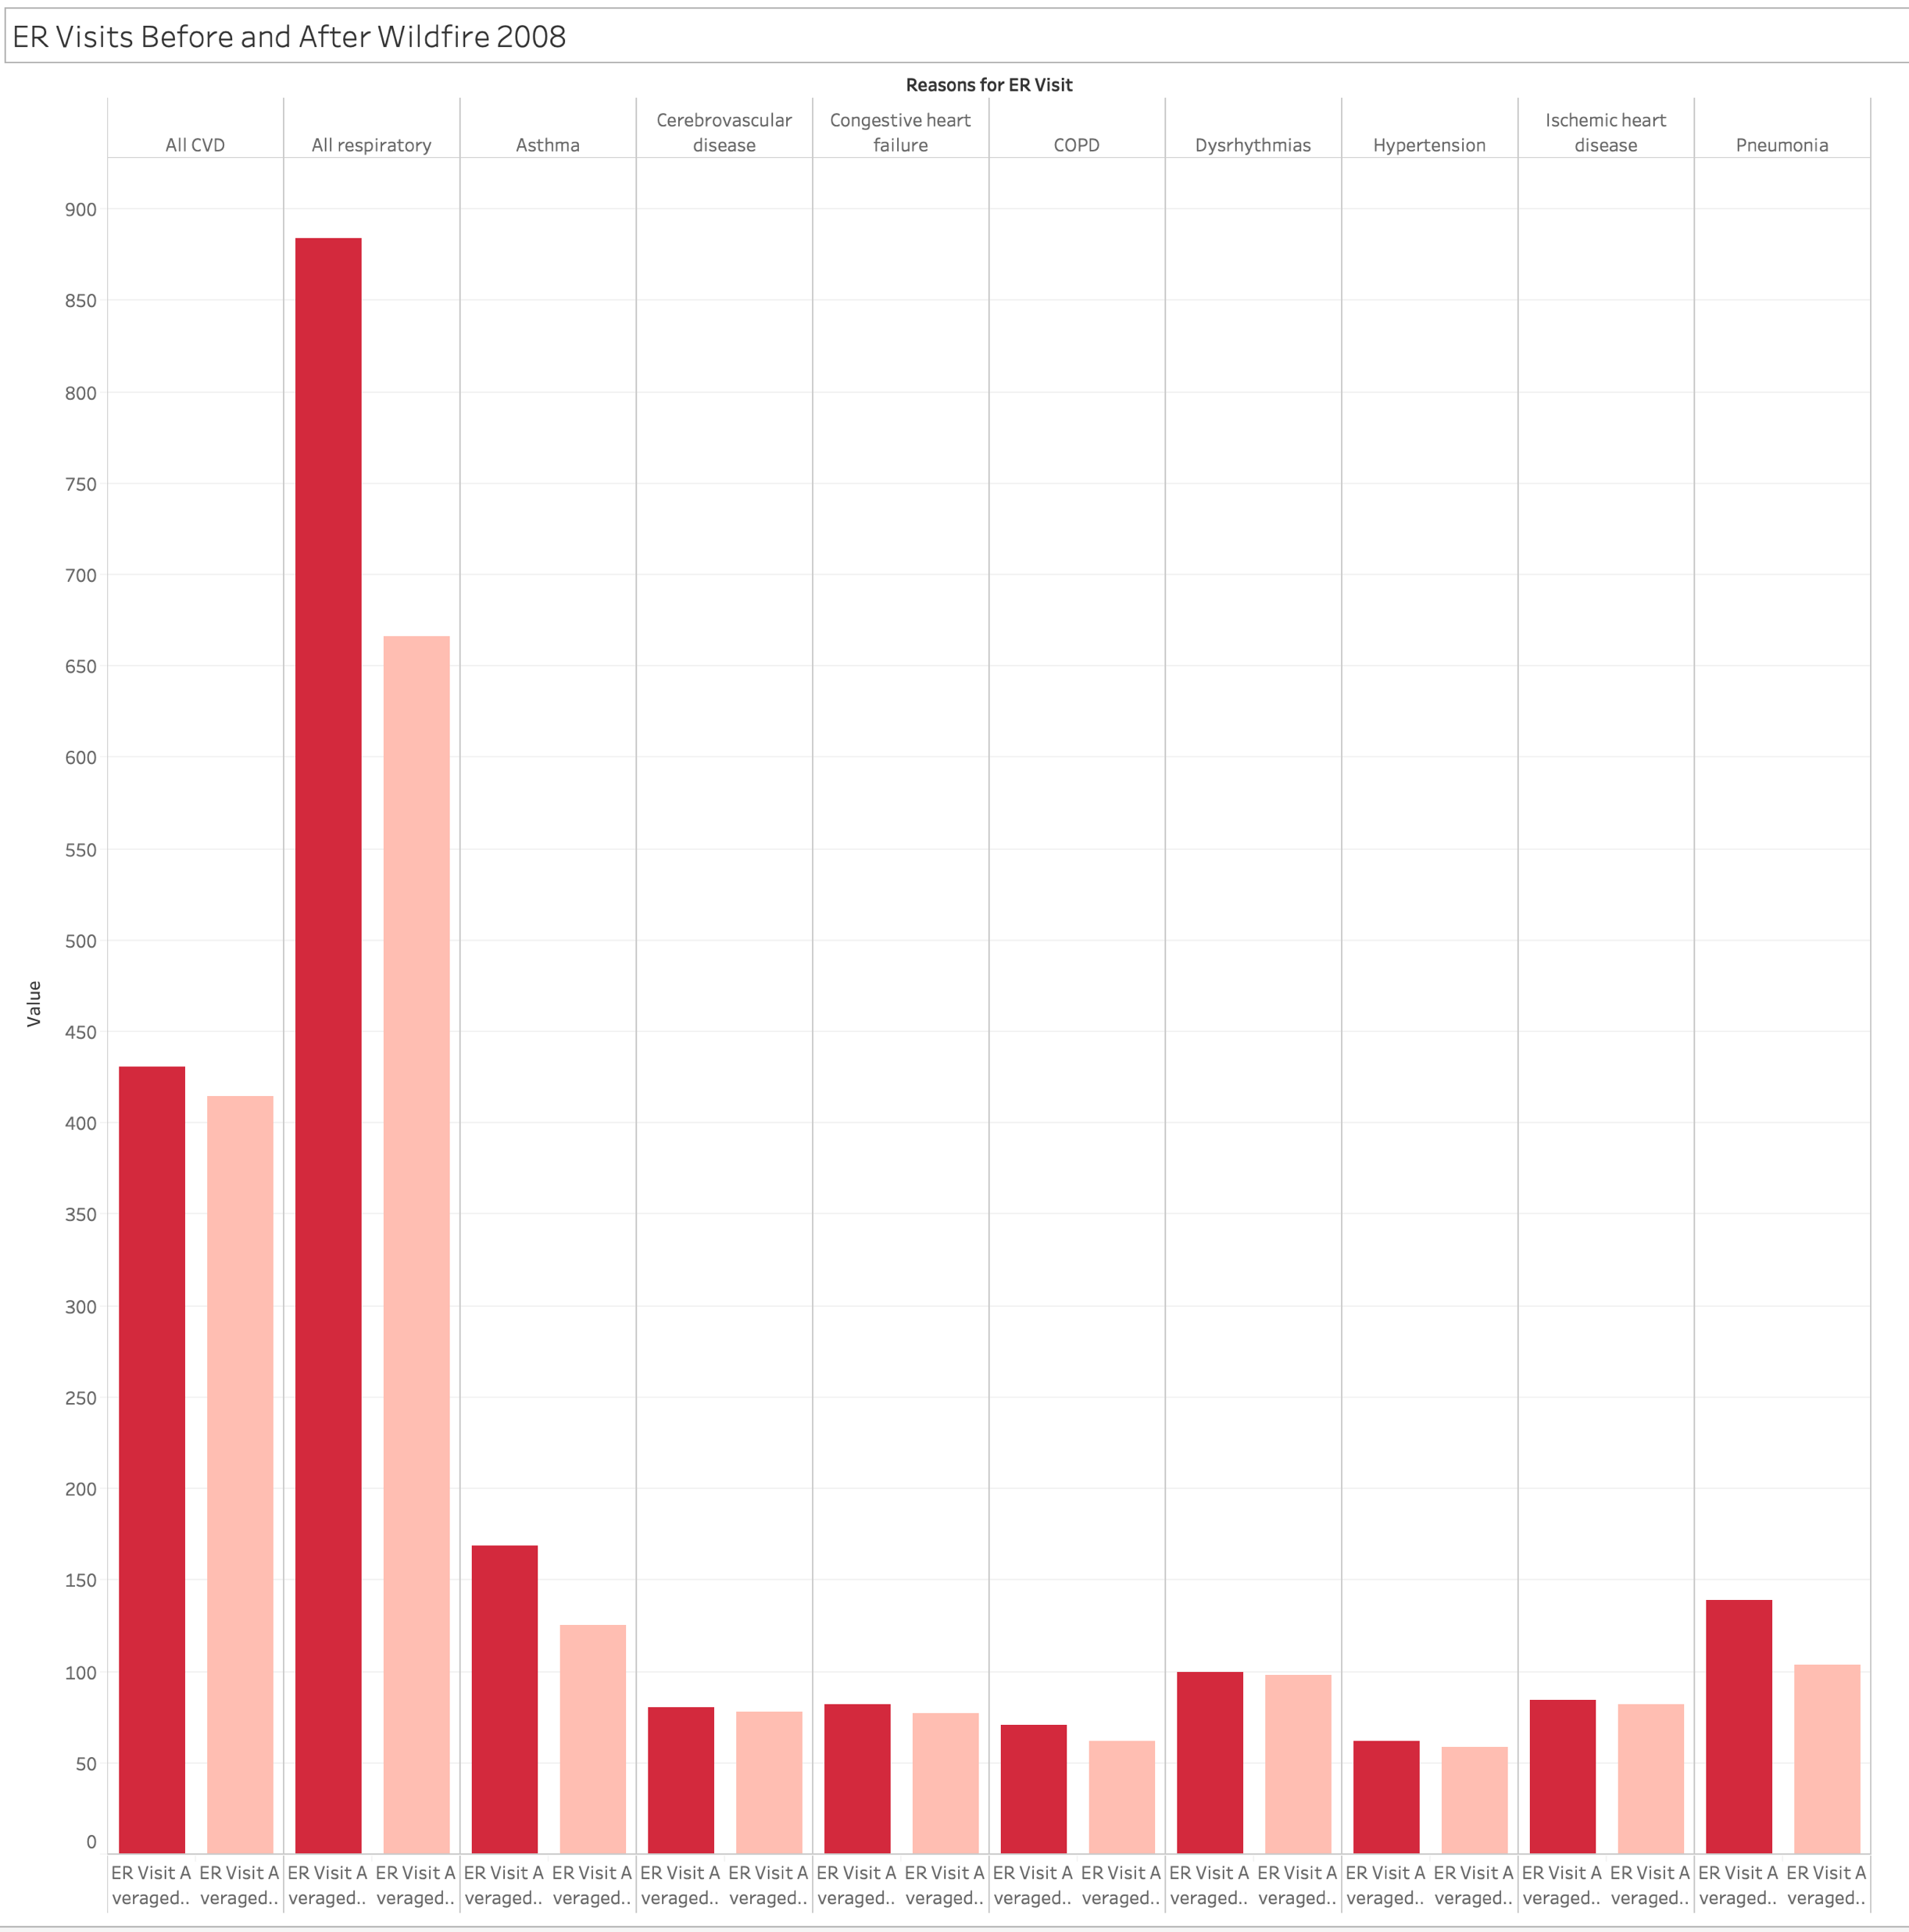
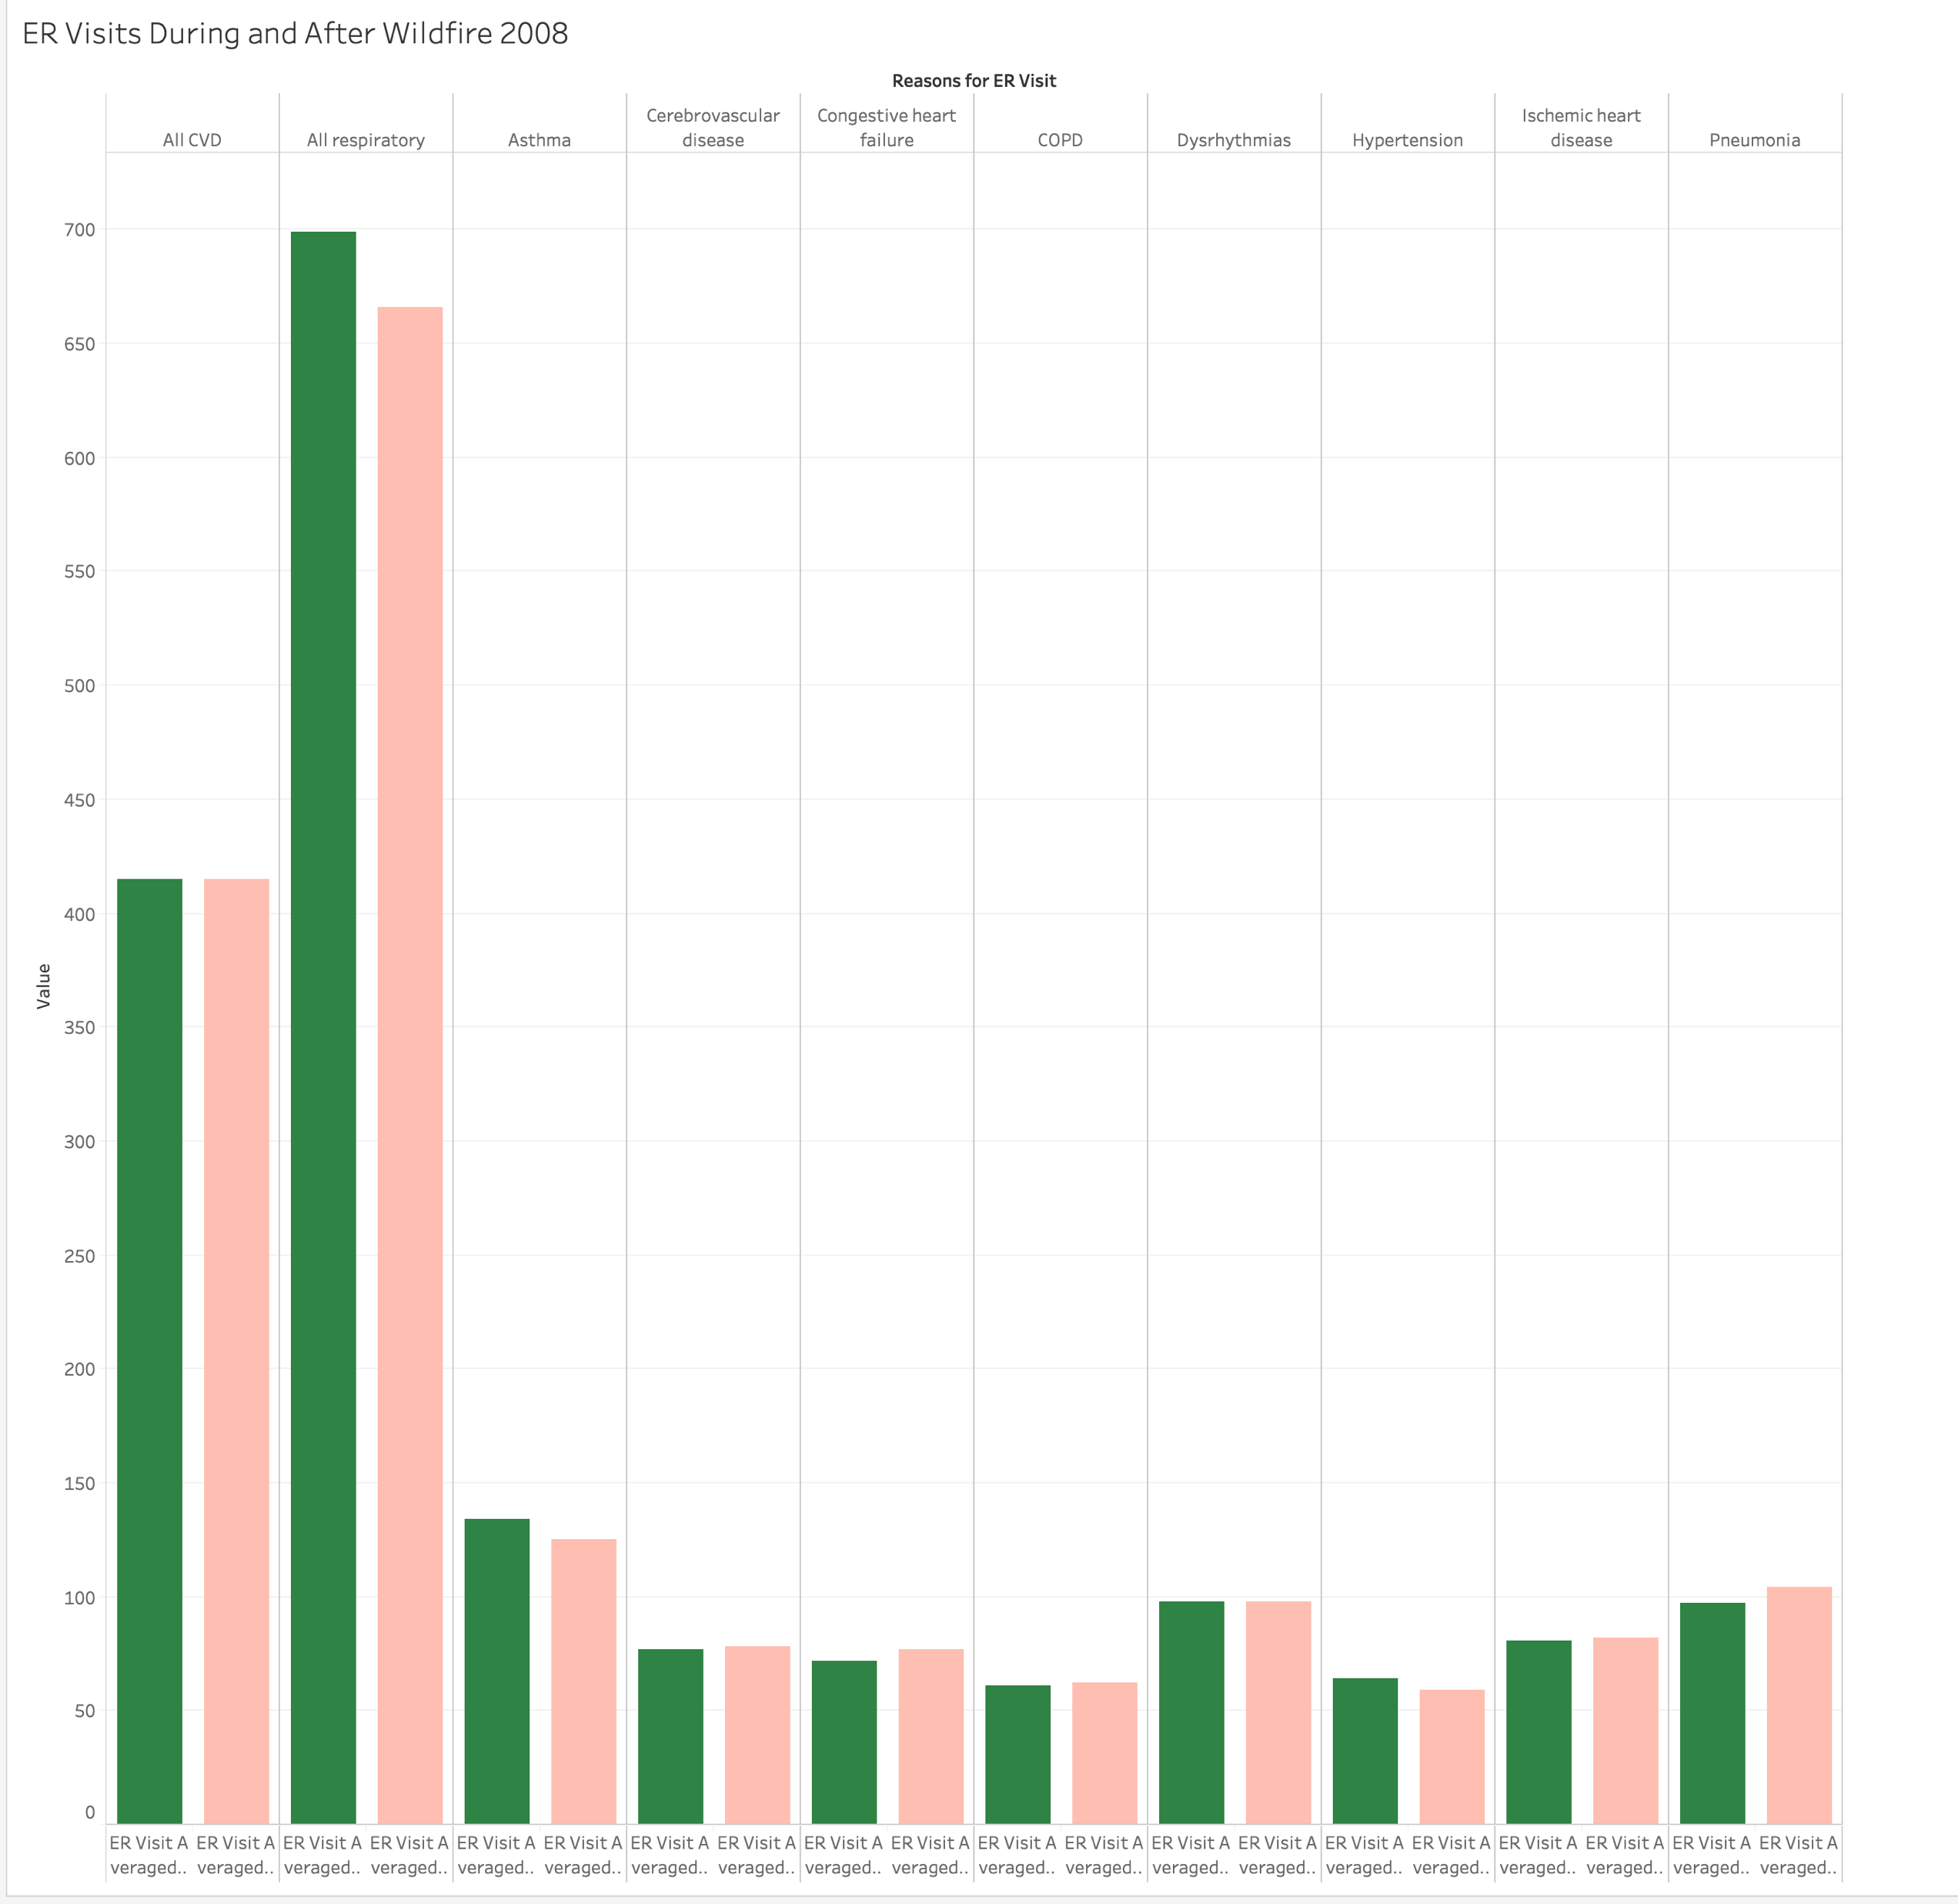

Slide 22
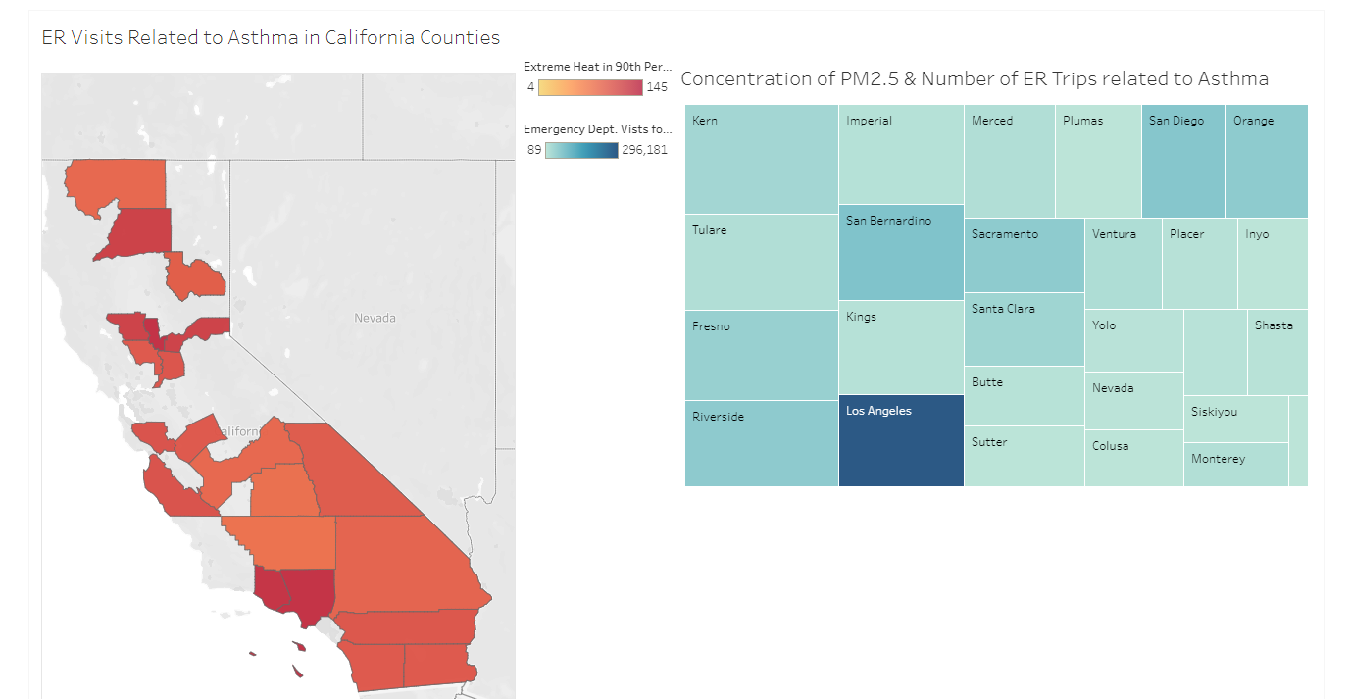

Slide 23
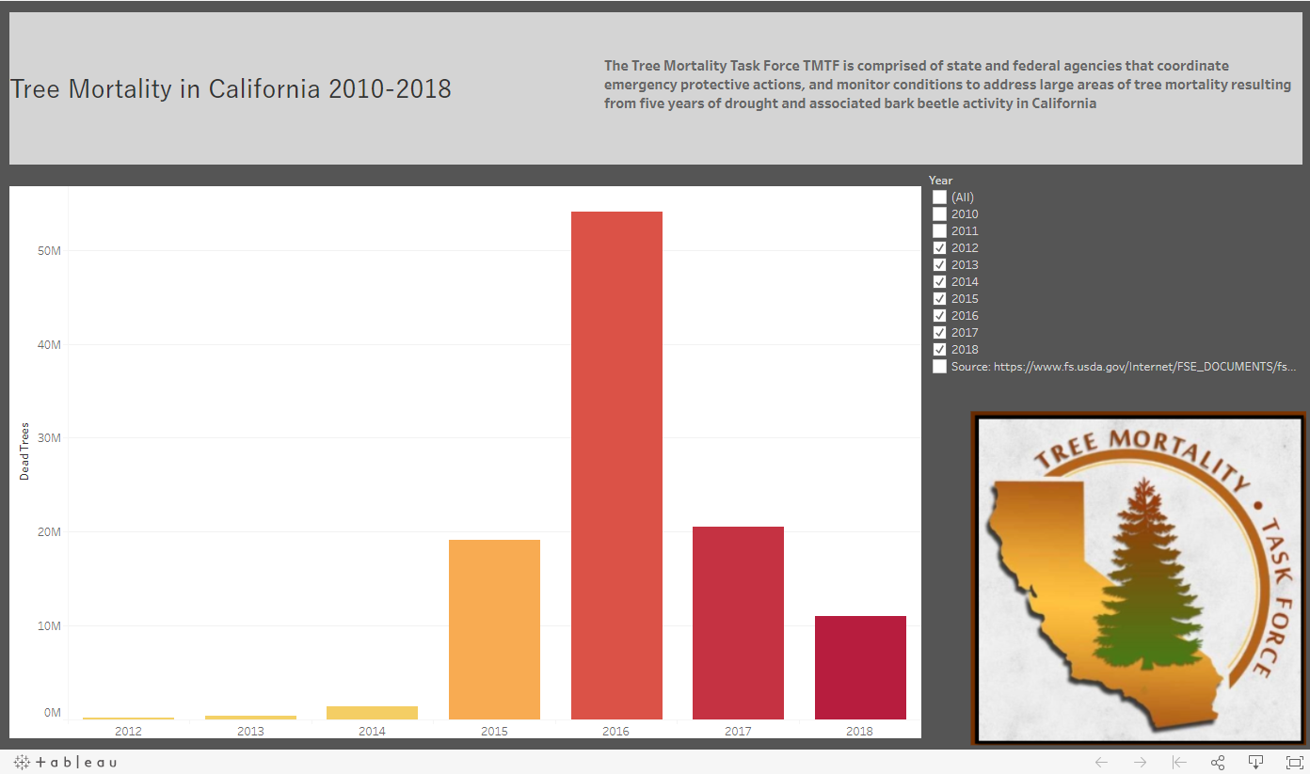
Tableau Visuals

Slide 24
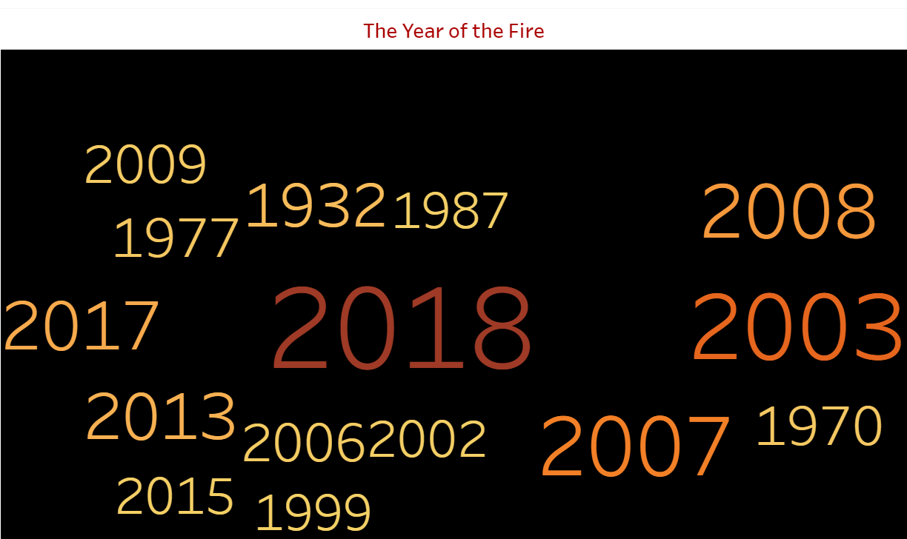
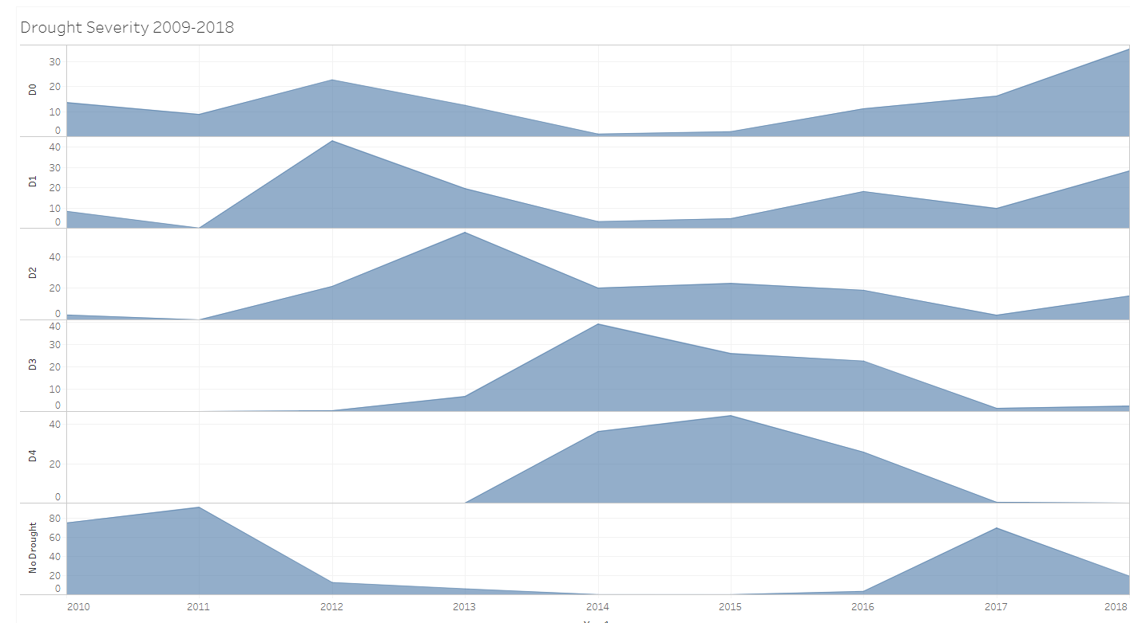
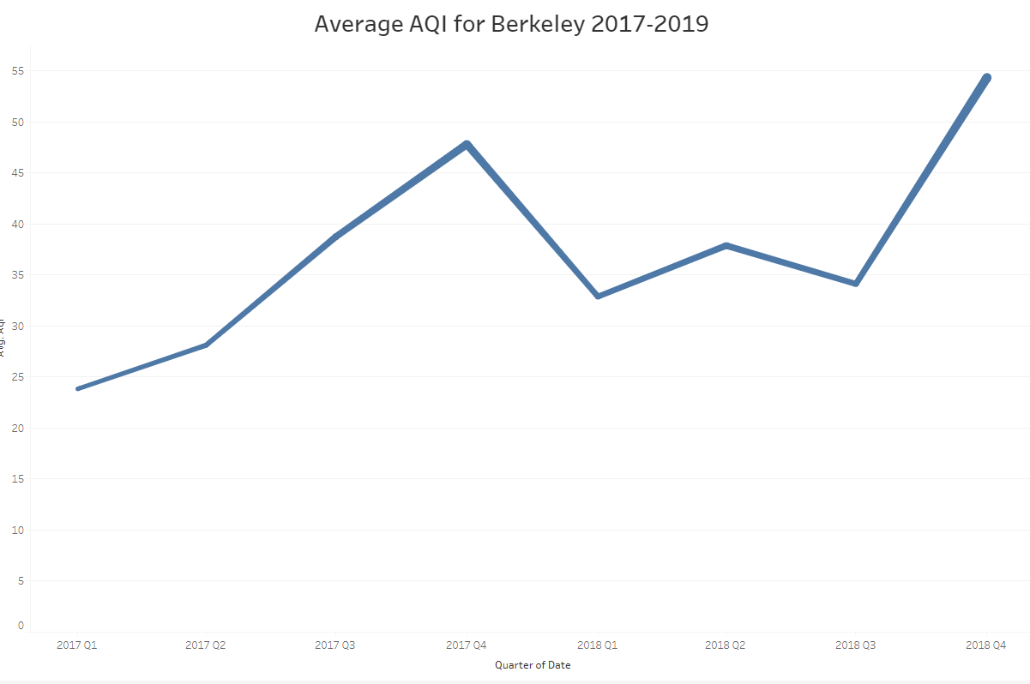
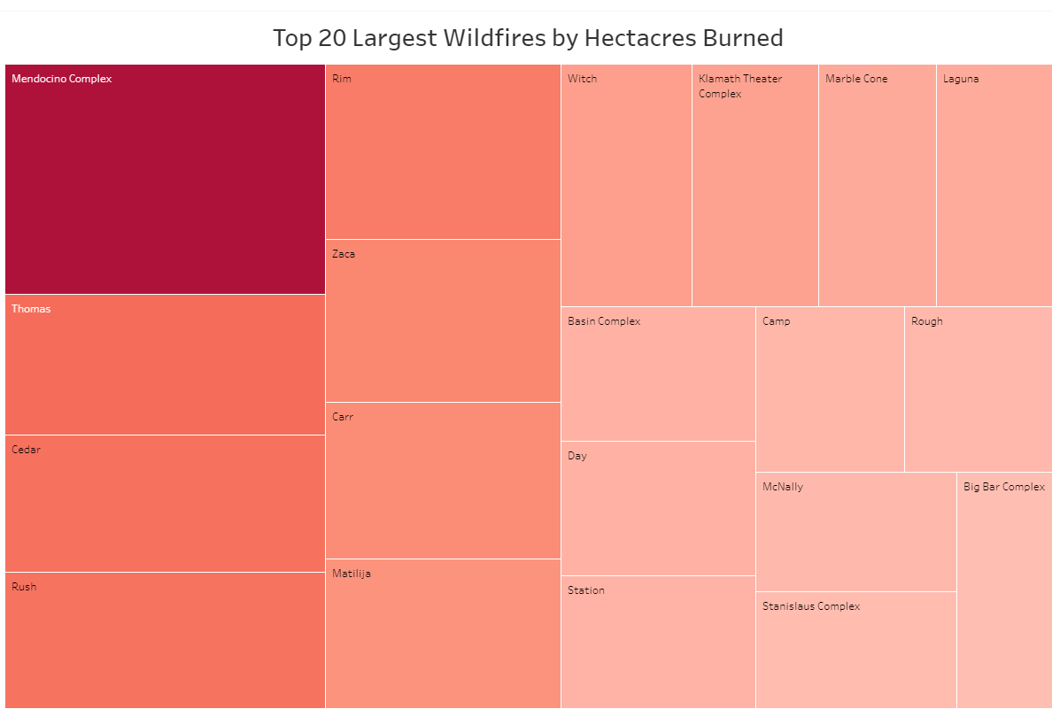

Slide 25
